Slide 1
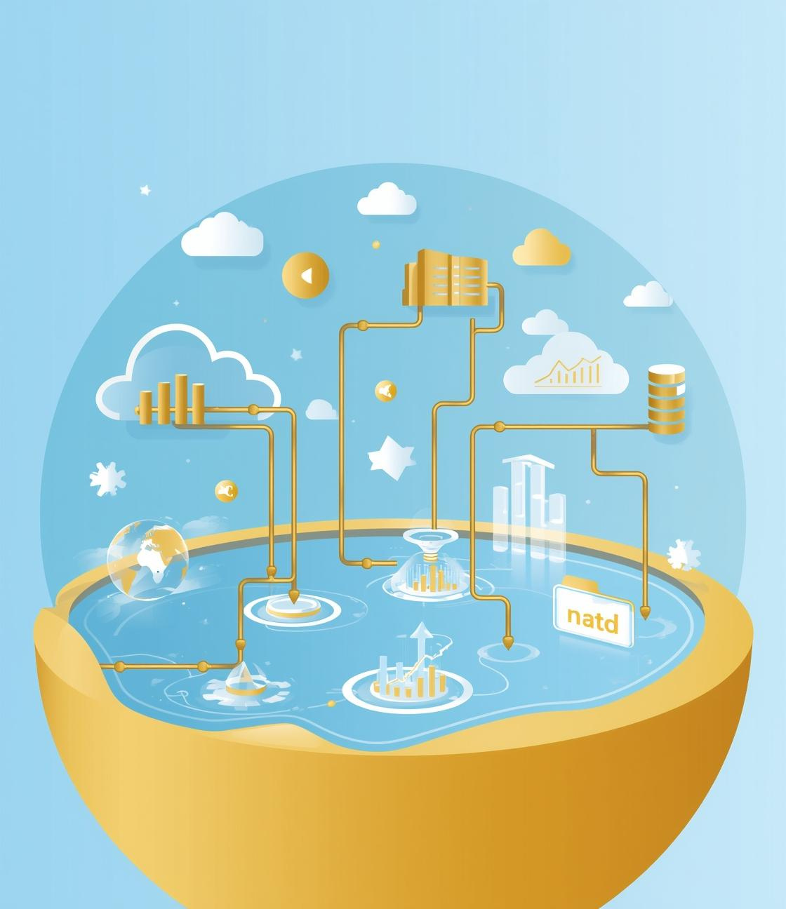
Modern ETL with Lakeflow & Delta Lake
Presented by Alladi Sindhu

Slide 2


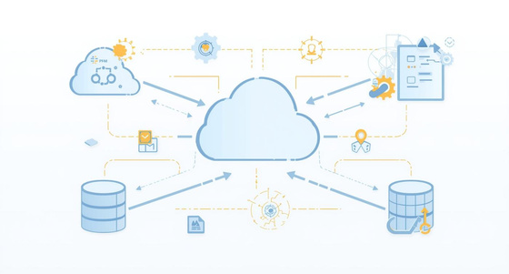
Rethinking ETL in Databricks
Declarative Pipelines
Streamline data processes with clear configurations.
Medallion Architecture
Organize data efficiently for enhanced analytics.
Traditional ETL:
Extract → Transform → Load
Heavy orchestration
Manual scaling
Separate batch & streaming systems
Cloud Native
Leverage flexibility and scalability in data management.

Slide 3
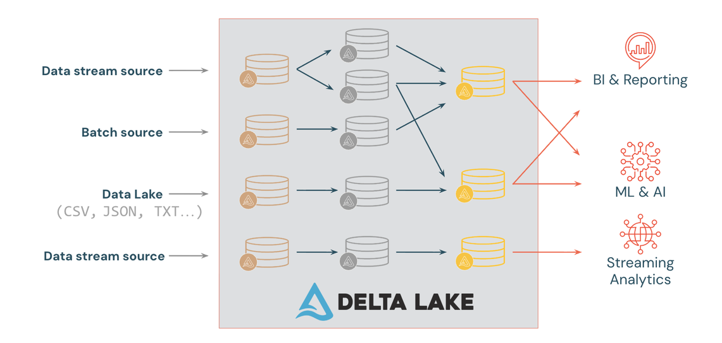
Data Transformation Overview
Bronze Layer (Raw Data)
Silver Layer (Cleaned Data)
Ingest raw data from external sources
Store data as-is (even if dirty)
Add metadata (load time, process ID)
Maintain historical backup
Enables reprocessing & traceability
Clean and filter Bronze data
Remove duplicates & handle nulls
Apply business rules
Join and enrich datasets
Gold Layer (Business-Ready Data)
Aggregated & curated data
Summary tables
Optimized for BI & reporting
Used for ML & analytics
Ready for downstream consumption

Slide 4
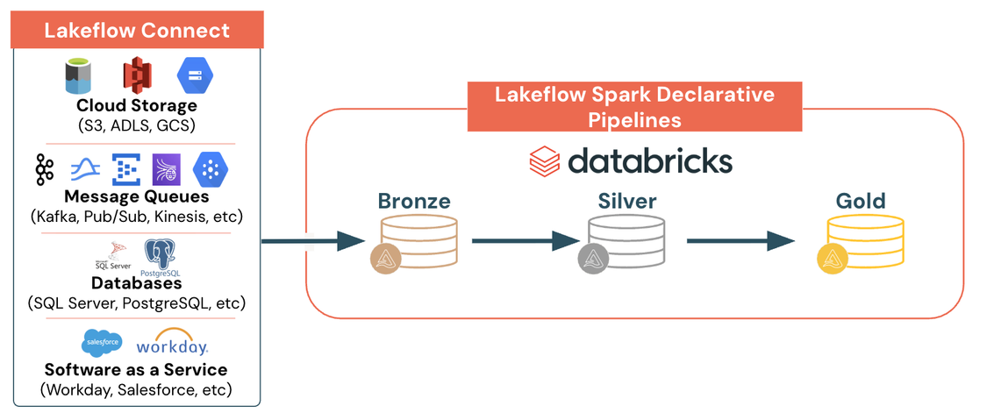
Lakeflow Spark Declarative Pipelines (SDP)
Lakeflow provides a declarative ETL framework where we define what transformation should happen, and the system manages execution automatically.
It simplifies:
Data ingestion
Incremental processing
Streaming pipelines
Pipeline monitoring
Error handling & scaling

Slide 5
From Ingestion to Transformation
Medallion Architecture
Step 1: Data Ingestion (Lakeflow Connect)
Data can come from:
Cloud storage (S3, ADLS, GCS)
Streaming platforms (Kafka, Pub/Sub, Kinesis)
Databases (SQL Server, Postgres)
SaaS applications (Salesforce, Workday)
Lakeflow Connect ensures reliable and scalable ingestion.

Slide 6







Step 2: Layered Transformation (SDP + Delta Lake)
Bronze – Raw Layer
Stores data exactly as received from source systems (batch or streaming) without modifications. Maintains full history for traceability and reprocessing.
Silver – Refined Layer
Cleans and standardizes data through deduplication, validation, and schema enforcement. Applies core business rules to improve reliability.
Gold – Business Layer
Provides aggregated, business-ready datasets optimized for reporting, dashboards, and analytics. Supports BI, ML, and KPI tracking.

Slide 7
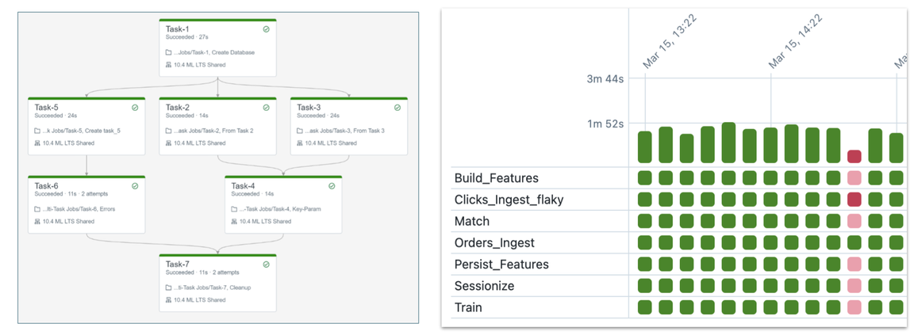
Orchestration with Lakeflow Jobs
Unified Orchestration in Databricks
No infrastructure or operational management required
Designed for:
Data engineers
Data scientists
Analysts
Supports multiple task types:
Notebooks
SQL Jobs
ML models
Python code
Spark Declarative Pipelines
Enables teams to:
Create jobs
Run workflows
Monitor execution
Repair failed pipelines
Works across any cloud
Fully-managed cloud-based general-purpose task orchestration service for the entire platform. For data engineers, data scientists and analysts to build reliable data, analytics and AI Lakeflow Jobs using Notebooks, Jobs for SQL, ML models and more. Easy to use point-and-click interface. Lakeflow Spark Declarative Pipelines can be a task in a Lakeflow Job.

Slide 8
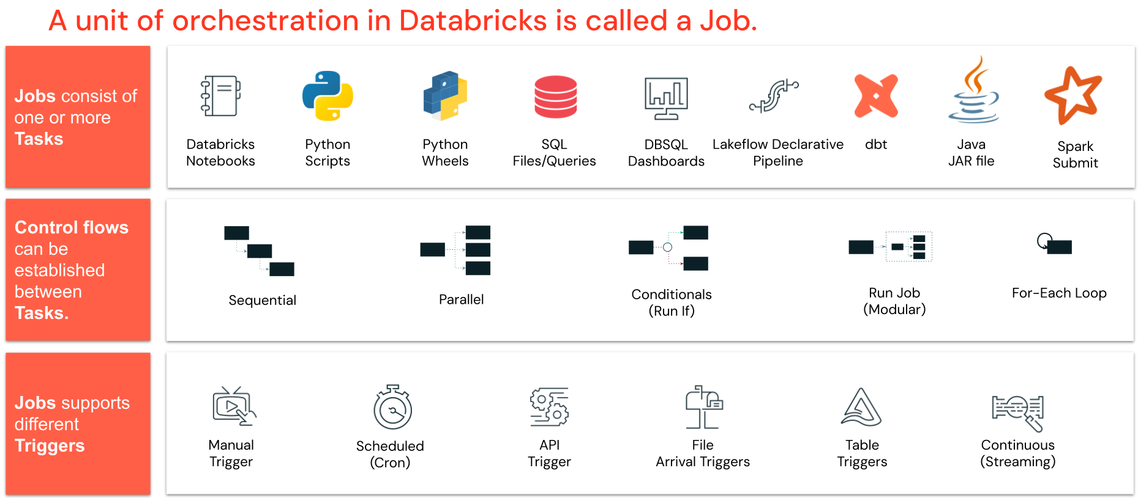
Building Blocks of a Lakeflow Job

Slide 9
THANK YOU

